Slide 1
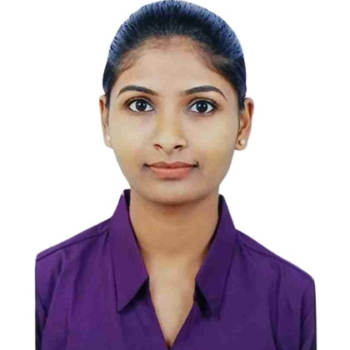

Ahiwale Akanksha Ashish
Master of Computer Application: 2020-22
Analyst/Software Engineer
Skills
Mumbai
C# | Basics, OOPS, Exception Handling ,Arrays ,Collection and Generics.
.NET Framework | ADO.NET, .NET 6 WEB API, Entity Framework , ASP .NET with MVC5.
JAVA | Basics, OOPS, Exception handling.
Database | SQL.
Tools | GIT, VISUAL STUDIO, SSMS.
UI Technology | HTML5 ,CSS, Bootstrap & Angular
Add On Skills | Communication Skills, Team work, Presentation
akanksha-ashish.ahiwale@capgemini.com
+91 9405287081
A4
Full Stack Developer
Worked on C#,ADO.NET, Entity Framework, SQL Server, ASP.NET with MVC5 and ASP.NET with WEBAPI
Knowledge on creating Single Page Web Applications using Angular
Understanding of RDBMS concept using SQL server.
Worked on HTML5, CSS3, JavaScript and Bootstrap for developing web pages.
Have knowledge on Git and GitHub.
Good understanding of Swagger
RollOff Management Tool :
Developing a web application project as a part of case study with the help of Angular for designing responsive frontend, web api for backend and SQL Server for working with database.
My Responsibilities :
Developing the intended solution by studying the key features of the system.
Developing API services for communicating with the database.
Technologies Used:
Frontend : Angular, HTML, Bootstrap 5
Backend : ASP.Net Web API
Database : SQL Server
Tools Used : Visual Studio, VS Code, SSMS, Swagger.
GithubLink

